Slide 1
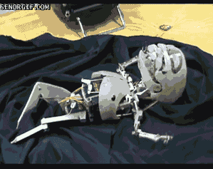

Lets Make Fun of Cyber Security
Prashant
Cyber Enthusiast
https://www.linkedin.com/in/prashantprofile/
YegSec Slack: @guy_fawkes
https://github.com/prashant-iiitm
X (formerly Twitter): @prashant_geek
Email: prashant_iiitmg@yahoo.com
Disclaimer: I am not a comedian, this presentation is

Slide 2

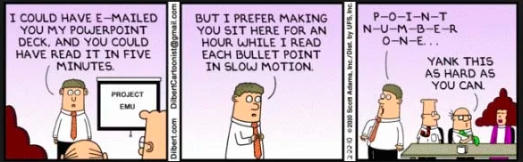
Let Cartoons Speak: Random Blabber* of Topics
Icon: When you see this, you are expected to laugh!!
*Wiktionary definition of blabber: to talk foolishly or incoherently

Slide 3
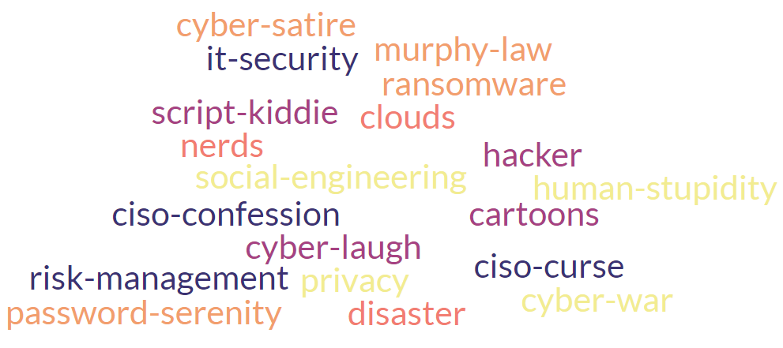
Word Cloud (ToC) of Cyber Fun

Slide 4
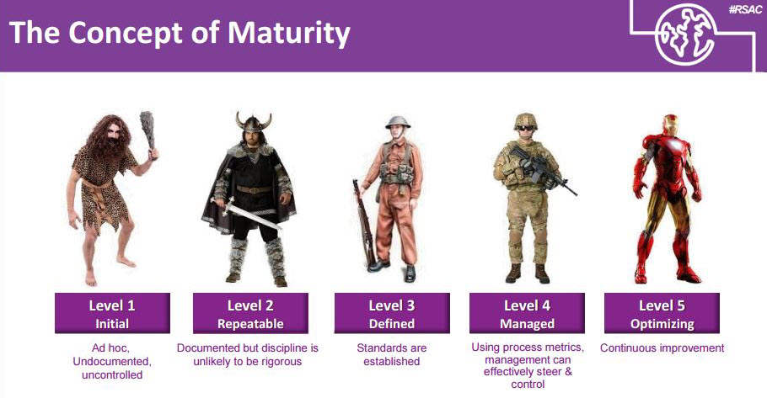
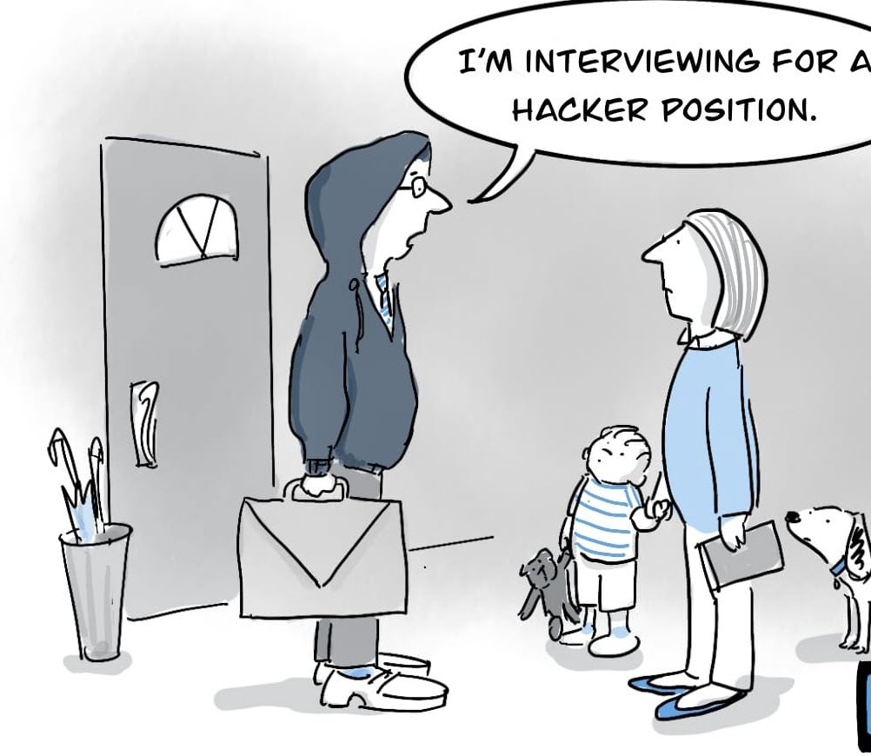
Cyber Careers: Bright and Dark Side

Slide 5

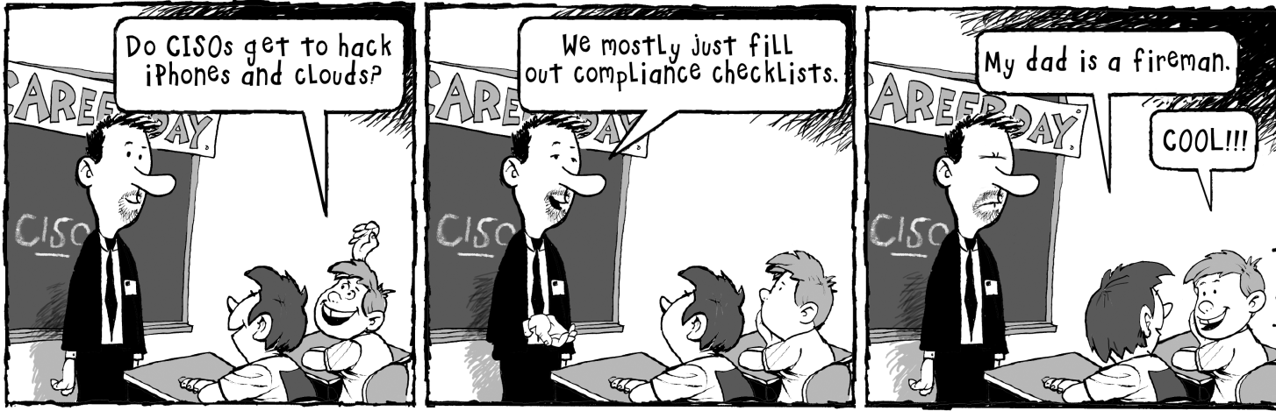
of the CISO

Slide 6
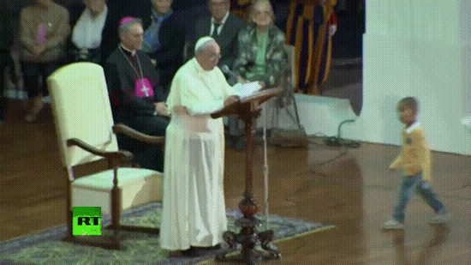
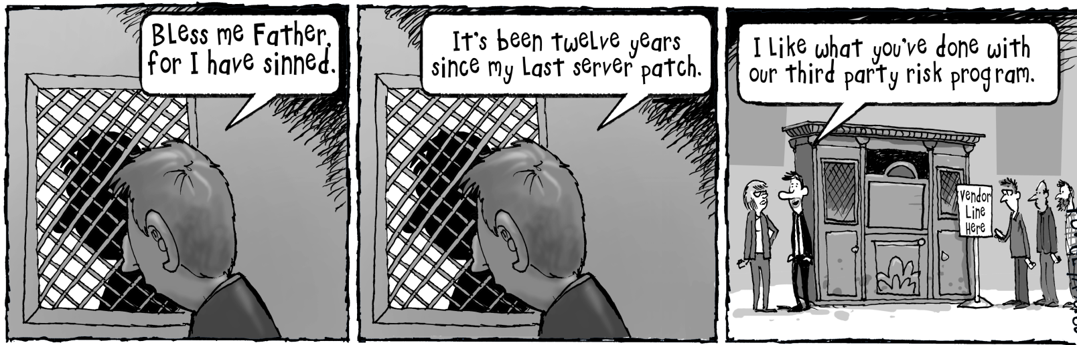
Are you too important to be breached
CISO Confession

Slide 7
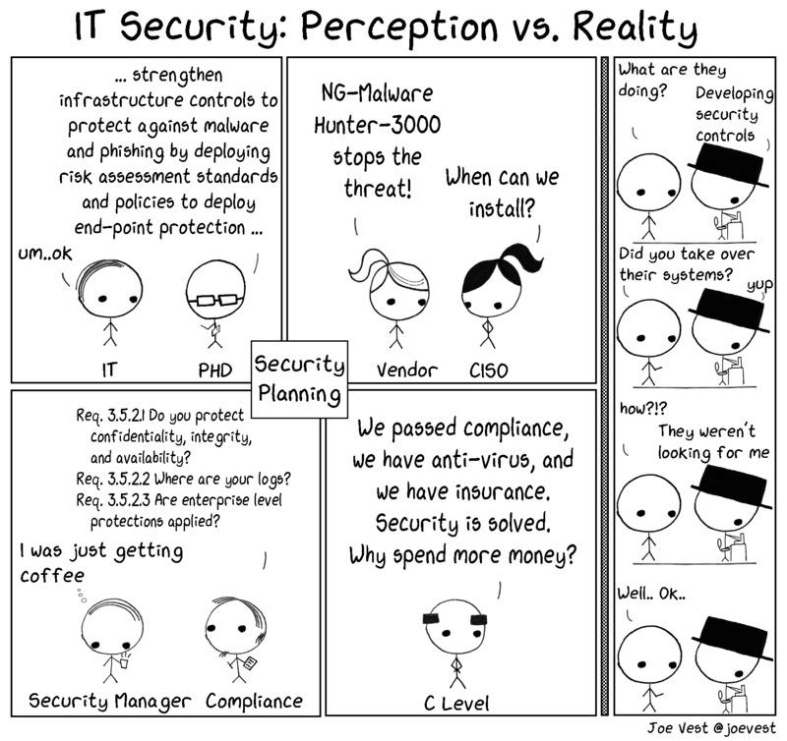

Slide 8
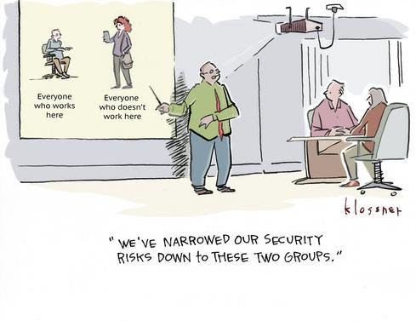
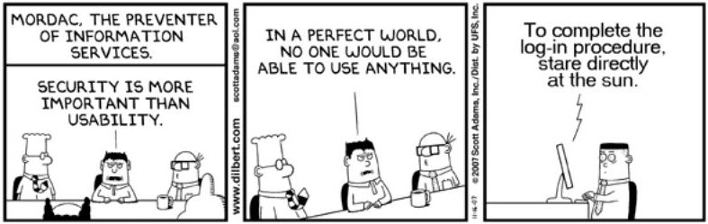
Risk Management: 101

Slide 9
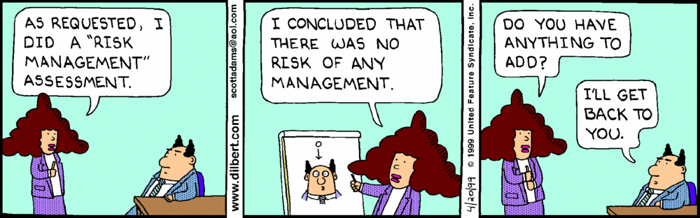
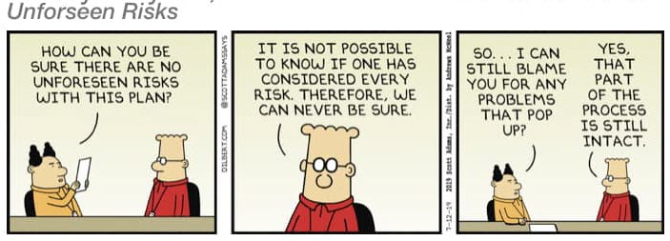

Slide 10

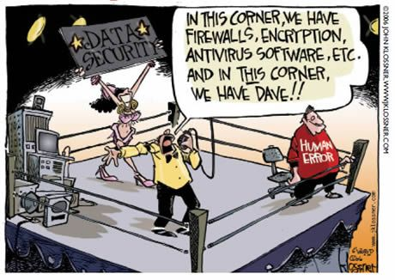
Social Engineering
Anyone who thinks technology can
solve a cyber problem in-fact
doesn’t understand the technology
and the problem.

Slide 11
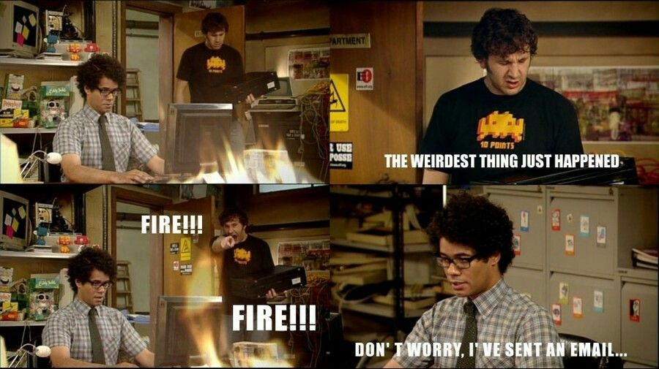
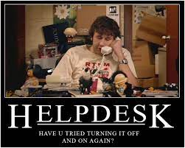
PEBKAC

Slide 12
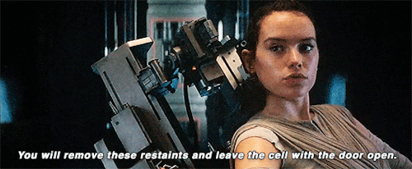
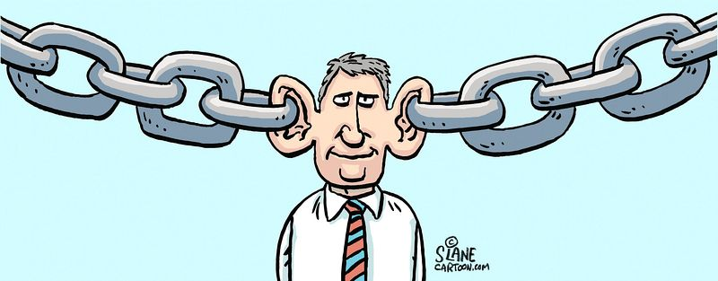
Thesis: Security is as strong as its weakest link.
Anti-Thesis: people are not the weakest link,
they are the most misunderstood link.

Slide 13
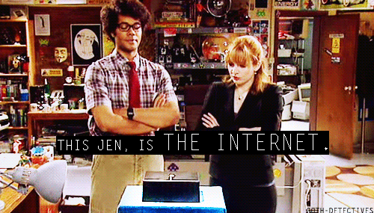
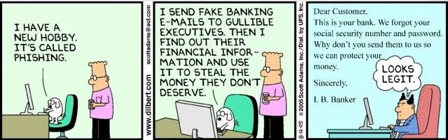
Cyber Awareness: C-Suite has solved Cyber !!

Slide 14
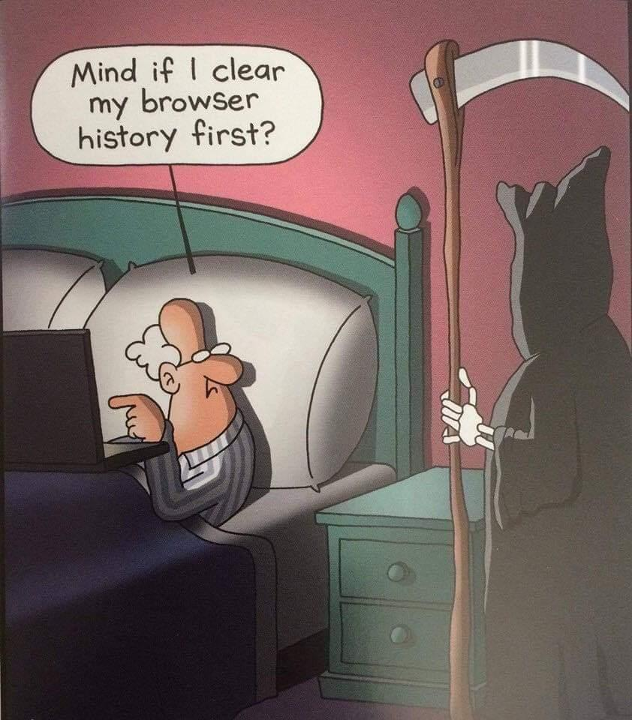
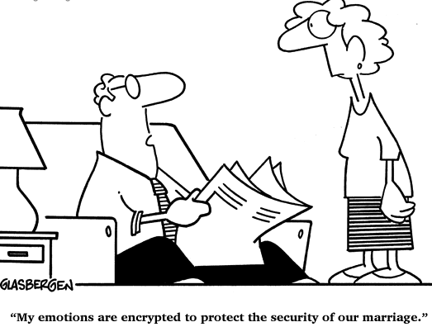
Privacy is Dead

Slide 15


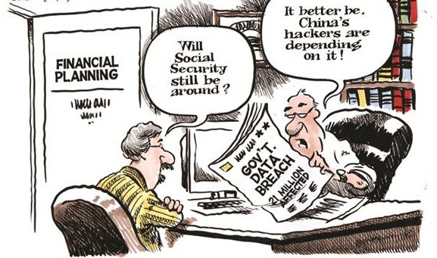
You Have No Privacy – Get Over It

Slide 16
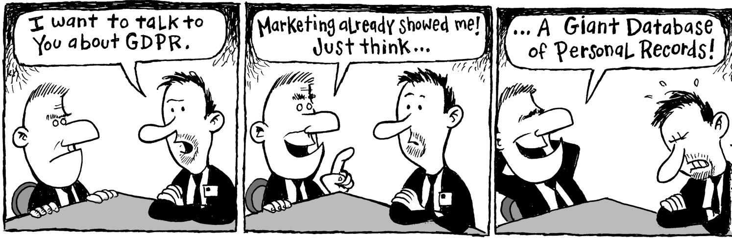
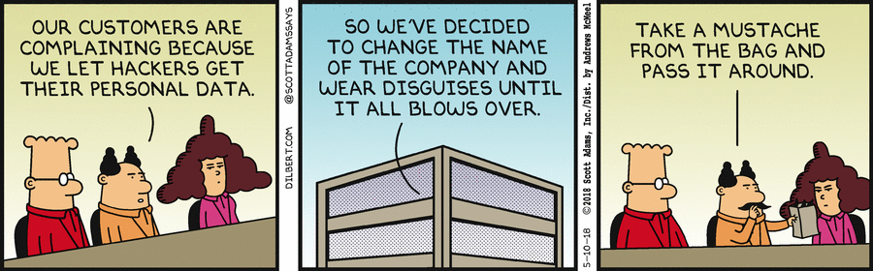
GDPR Full Form
GDPR Compliant

Slide 17
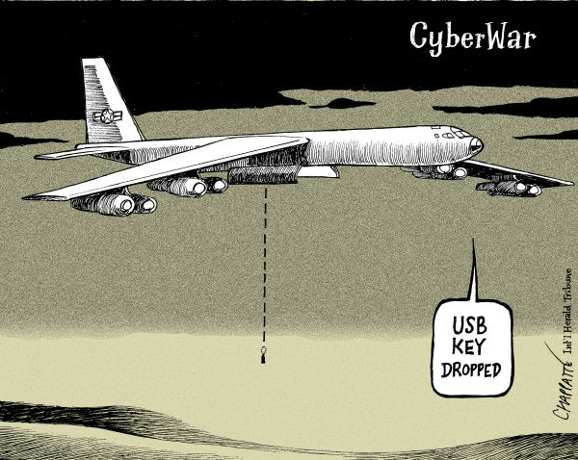
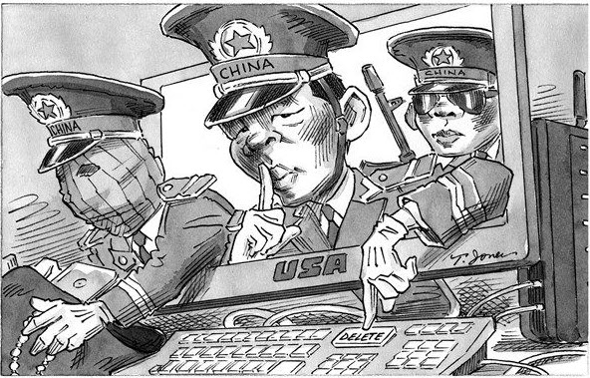
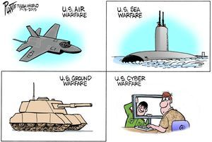
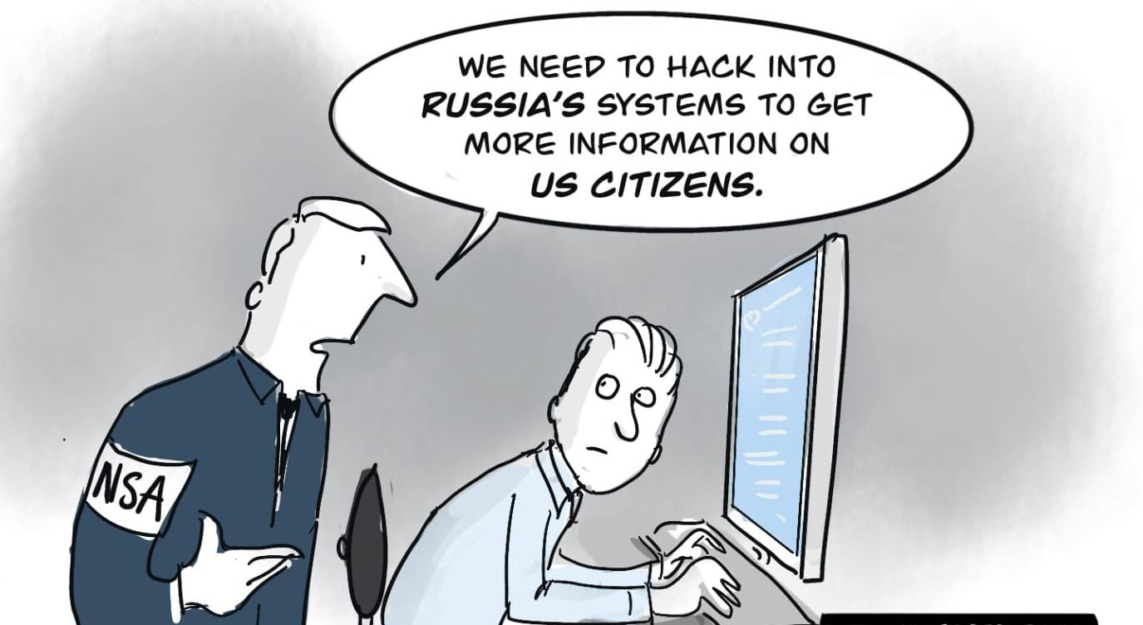
Cyber Warfare

Slide 18
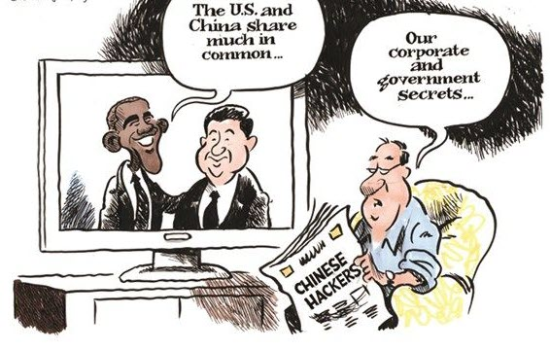
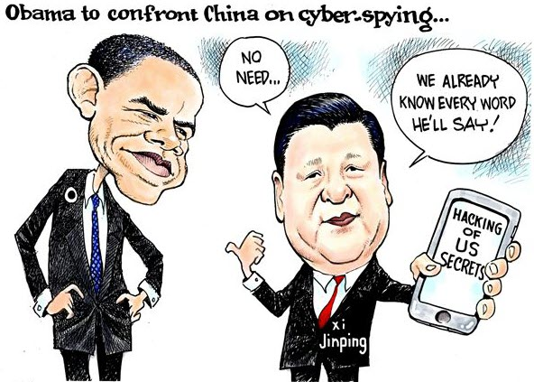
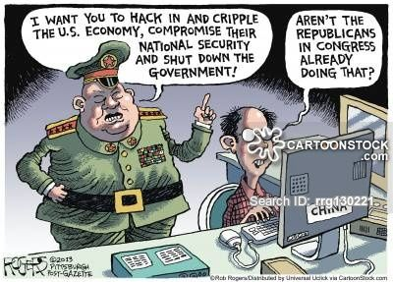
Cyber Political Satire

Slide 19
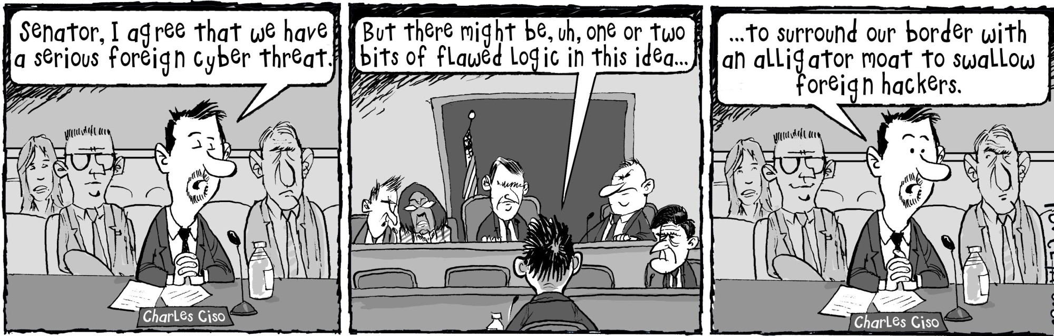
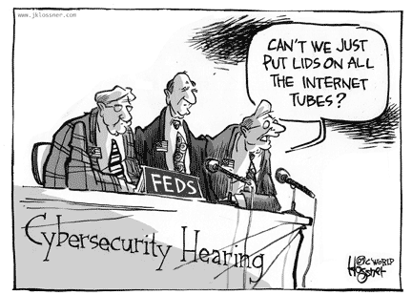

Slide 20
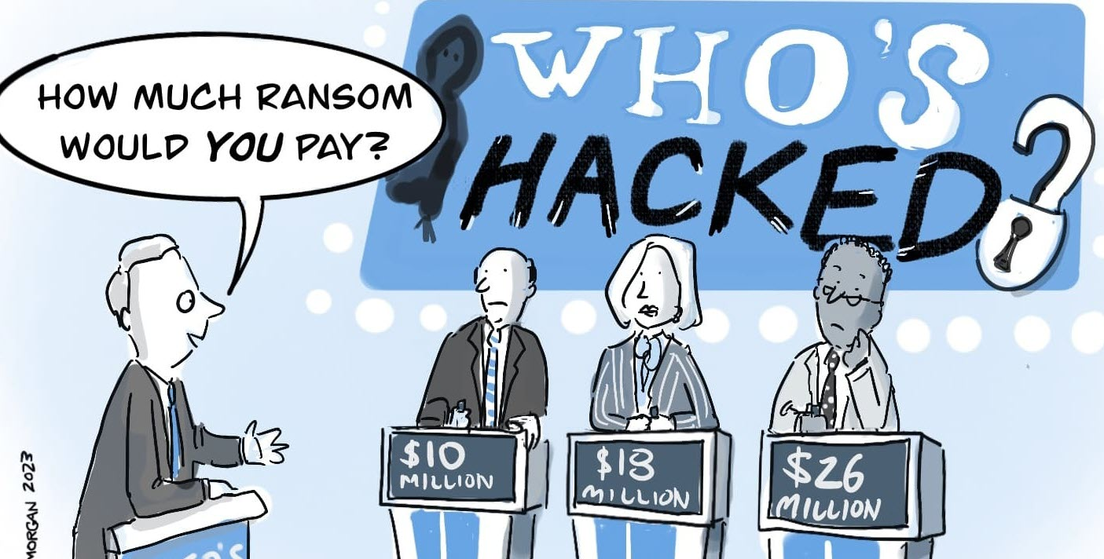
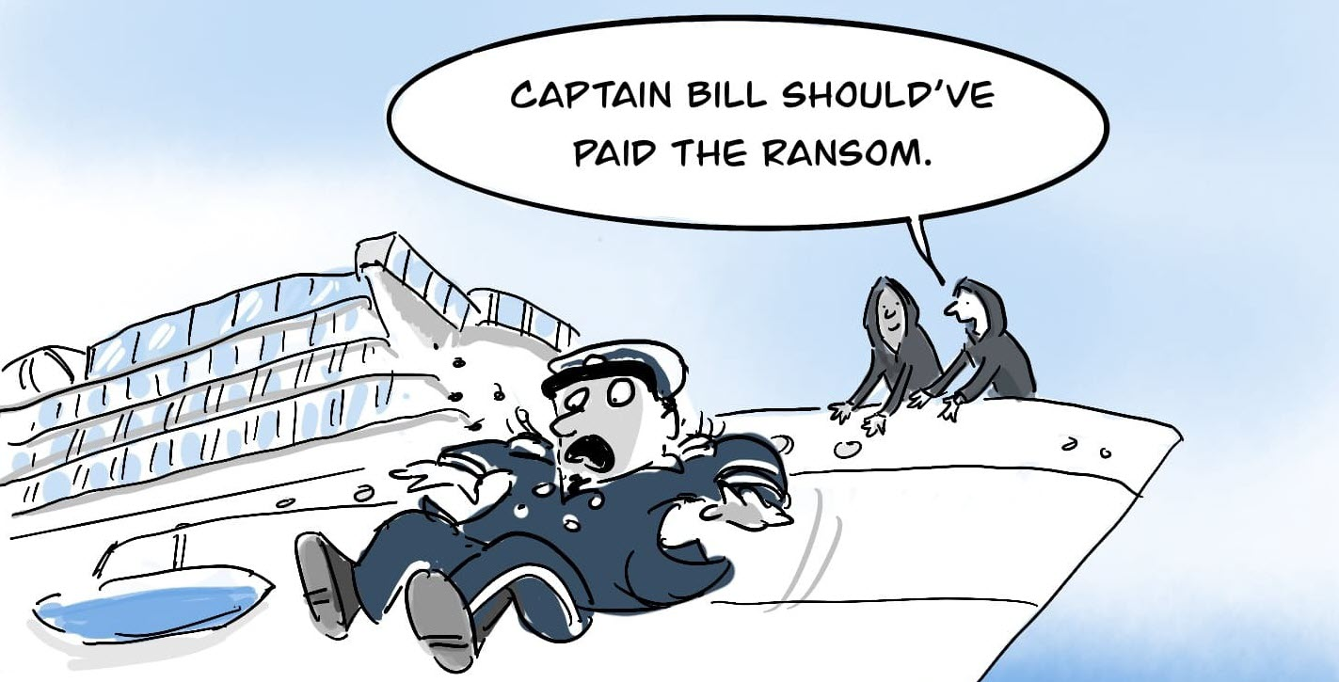
Ransomware To Death

Slide 21
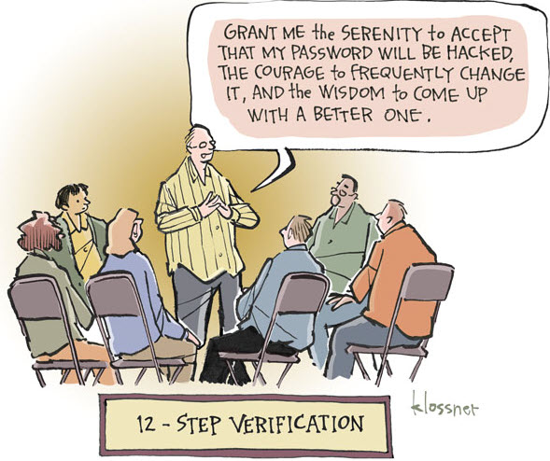
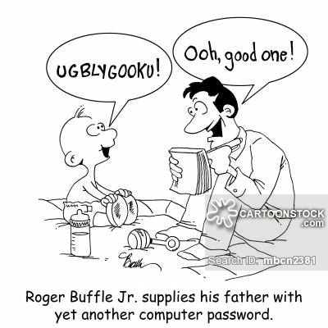
Pa$$w0rd in need is a Pa$$w0rd in deed!!
Pa$$w0rd $erenity Pr@yer

Slide 22
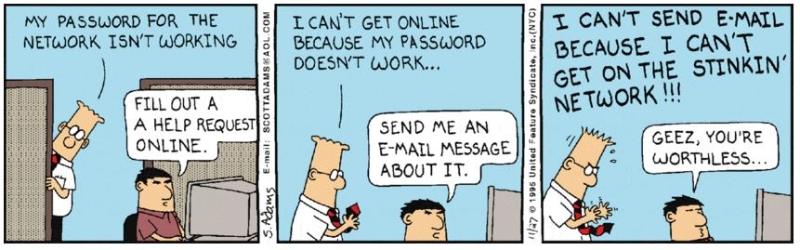
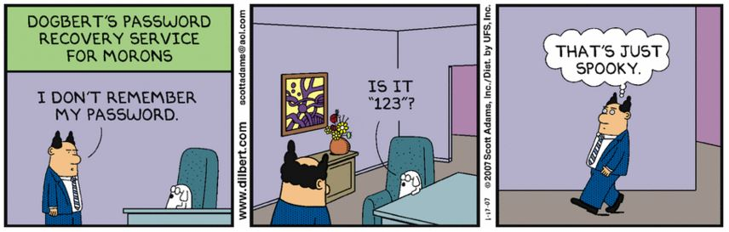

Slide 23
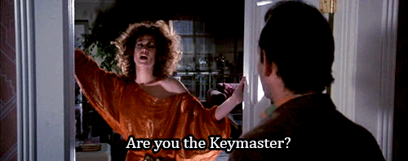
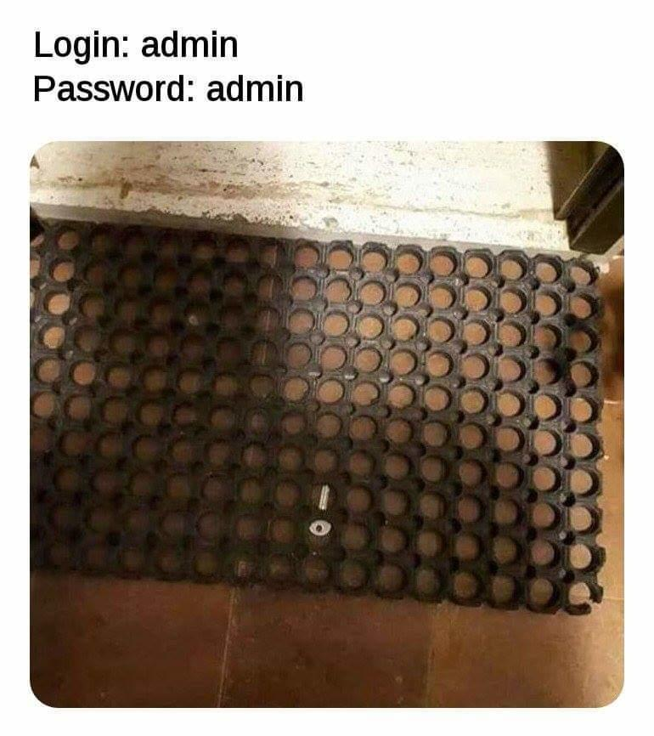
Kerckhoffs's principle of encryption
Getting the encryption key hook or by crook:
Proverbial Hindu Religious Scripture Gita for cyber warfare:
Sam: Persuade
Dam: Purchase
Dand: Punish
Bhed: Exploit
"Saam, Daam, Dand, Bhed" is an age-old Hindi idiom that translates to 'by any and all means.'

Slide 24
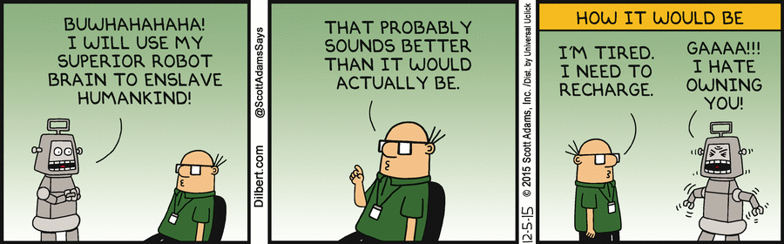
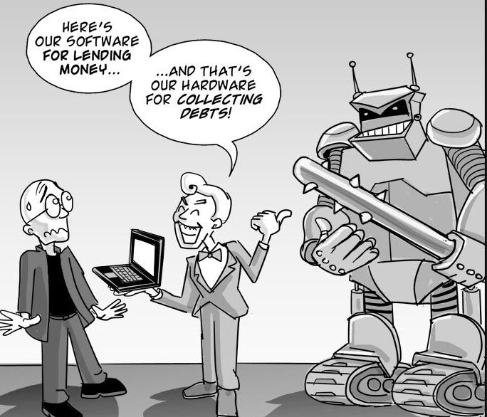
Murphy’s Law on AI: When everything is going AI, humans have become stupid.

Slide 25
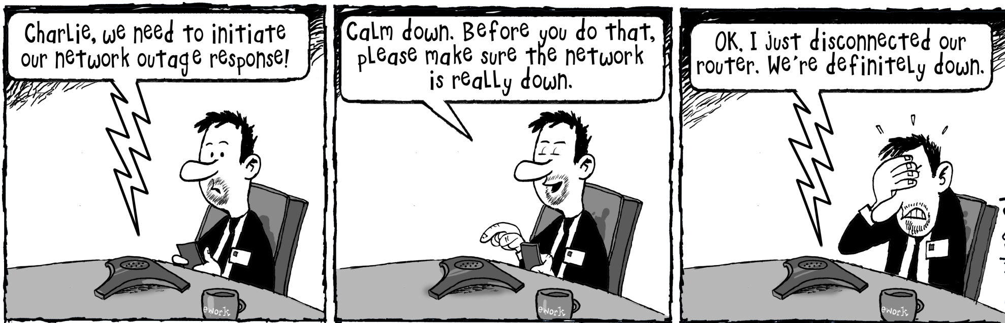
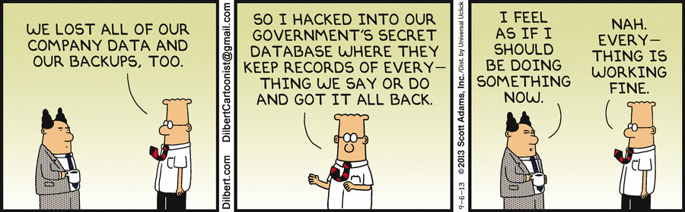
Murphy’s Law on Disasters (my innovation): When a disaster has to occur, it will occur !!
Full Proof Disaster Recovery Plan

Slide 26
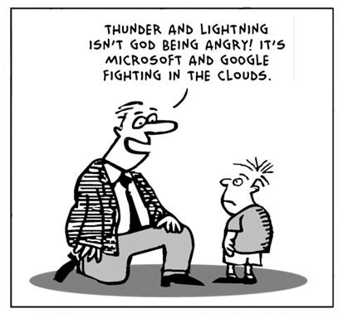
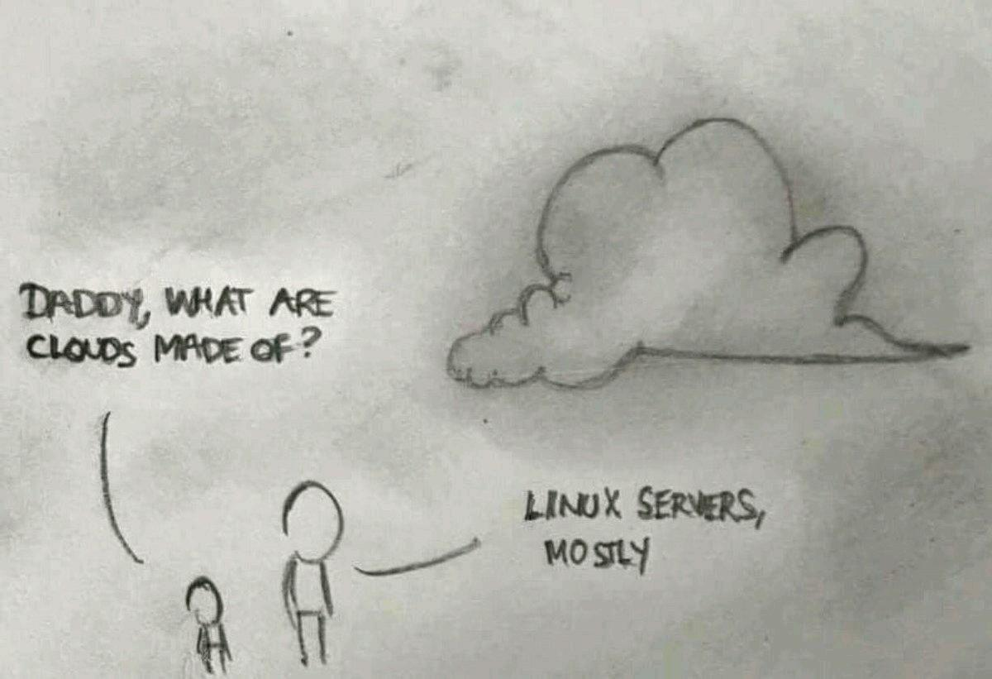
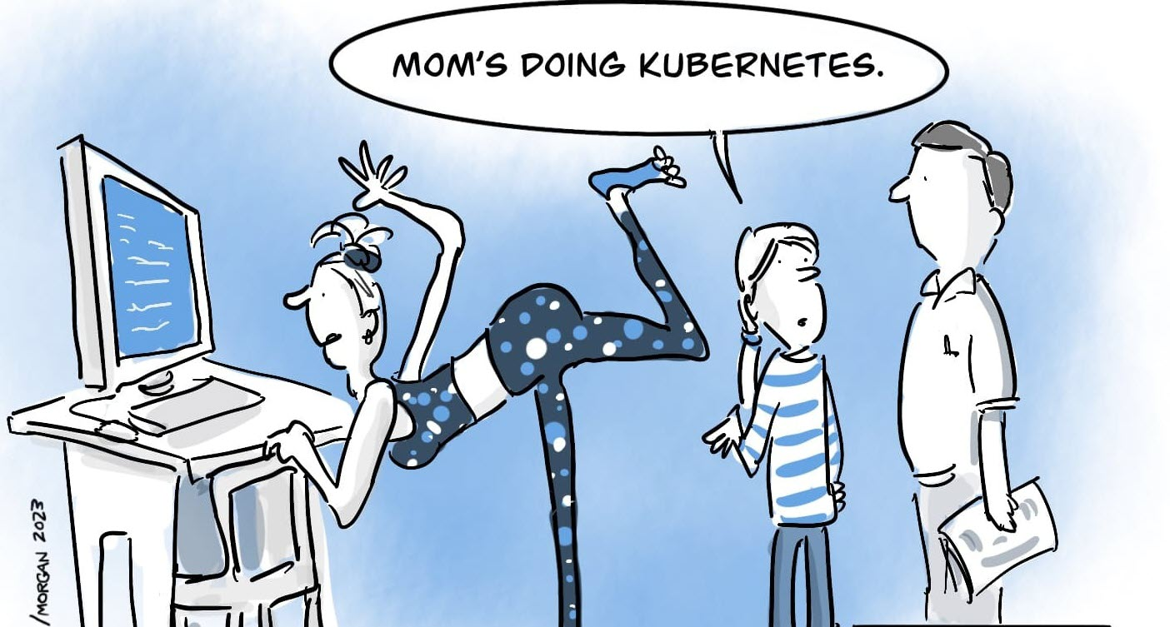
Clouds are Infallible

Slide 27
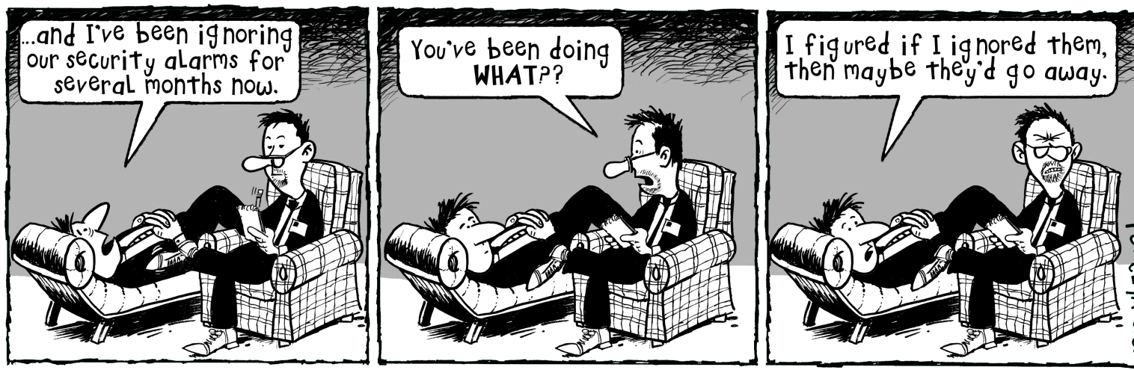

For the Nerds

Slide 28


